Slide 1

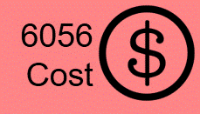
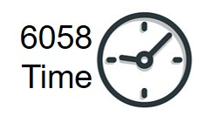






Some slides are exclusive to either 6056 or 6058
Exercises
Do the exercise prior to next slide
Videos
MGMT 6058 Module 4
Solution Slide
PPT Animations
Project Scheduling:
Critical Path, Duration, Laddering
Exercise Simulation
Use Excel
M4 HANDOUT EXERCISE Delta Proj Fw Pass V1.pptx
M4 Digital EXERCISE Delta Proj Fw Pass V1.xlsx
Printout
M4 PRINTOUT or DIGITAL Std Dev on critical path Delta proj.docx
See text in “slide note” for more details
M4 Math is Fun, Standard Normal Distribution Table
https://www.mathsisfun.com/data/standard-normal-distribution-table.html
Use the Z Tables in the Normal Distribution Table.pdf on FOL

Slide 2
Module 4 Learning Objectives
Construct the critical path for a project schedule network using forward and backward passes.
Identify activity float and the manner in which it is determined.
For duration estimates, apply common forms of estimation for project work, including ROM, ballpark estimates and definitive estimates.
Understand Laddering & Hammocks
Understand the steps that can be employed to reduce the critical path.
Duration Contingency Reserves
Calculate the probability of a project finishing on time under PERT estimates.

Slide 3
Constructing the Critical Path
Forward pass – an additive move through the network from the project start to finish
Backward pass – a subtractive move through the network from the project finish to start (backwards)
Critical path – the longest path from end to end which determines the shortest project duration
Why the longest not the shortest?
Notes:
The longest path dictates how long it will take to complete the project. We could have a path that is 13 days, a 2nd that is 11 days, but if the 3rd path is 27 days – then it will take 27 days until we can say the project is complete.

Slide 4
Rules for Forward/Backward Pass
Forward Pass Rules (ES & EF)
ES + Duration = EF
EF of predecessor = ES of successor
Largest preceding EF at a merge point becomes ES for successor
Backward Pass Rules (LS & LF)
LF – Duration = LS
LS of successor = LF of predecessor
Smallest succeeding LS at a burst point becomes LF for predecessor
At final node EF=LF
This is much easier to “see” by drawing (“doing”) a network diagram and filling out information in the nodes

Slide 5
For the Project Delta info on the next page:
Create a Network Diagram
Label nodes with ES, EF, LS, LF, Float, Duration, ID number and Activity Descriptor
Identify the Critical Path
What does float or slack mean?
Notes:
Float and slack are the same thing, and they mean the amount of spare time available in an activity's duration – without delaying the project. An Activity with 2 days of slack, means the activity could run late by 2 days without delaying the project finish.

Slide 6
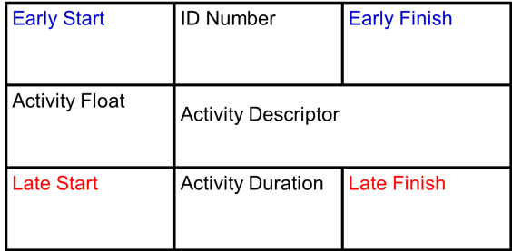
Project Delta Information
Table 9.4
H Presentation E, F, G 2

Slide 7
Project Delta Exercise
First hand draw the network diagram on a piece of paper
Just the node, the name, duration and arrows
Then work on your Exercise Handout or Excel file
Use Excel
M4 Digital EXERCISE Delta Proj Fw Pass V1.xlsx
M4 HANDOUT EXERCISE Delta Proj Fw Pass V1.pptx
Printout

Slide 8
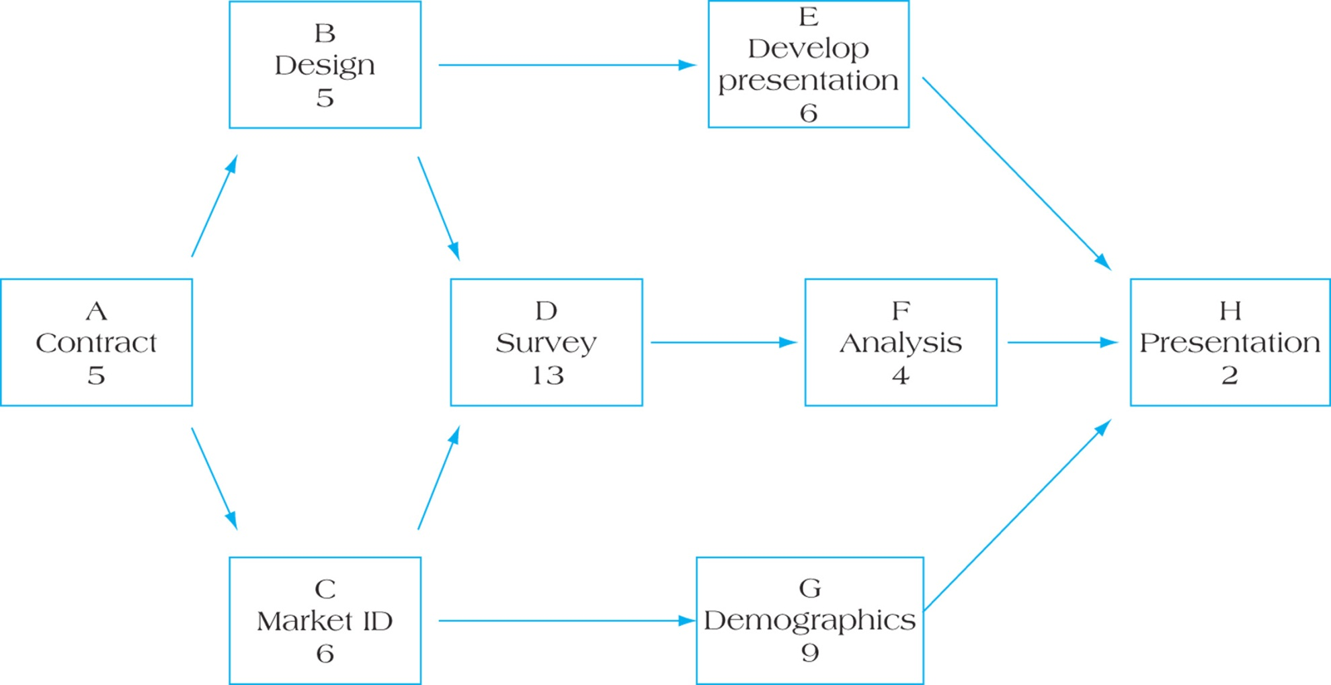
Follow the key at the top right
Figure 9.16 Partial Project Activity Network with Task Durations

Slide 9

An Example of AON node details of an Early Start (ES) -- when using Method 1, an approach of zero (0) in the ES of the first node.
3 K 5
Dur = 2
3 K 5
Dur = 2
Days
0
1
2
3
4
5
6
0 J 3 Dur = 3
1st day
2nd day
3rd day
4th day
5th day
K is only occurring on the 4th and 5th Day, NOT on 3, 4, 5 Duration = 2
0 J 3 Dur = 3
3 L 7 Dur = 4

Slide 10
A 2nd Example of AON node details of an Early Start (ES), when using Method 2, an approach of one (1) in the ES of the first node.
4 K 5
Dur = 2
4 K 5
Dur = 2
But note we’re using Method 1 per previous slide in this course
Days
0
1
2
3
4
5
6
1 J 3 Dur = 3
1st day
2nd day
3rd day
4th day
5th day
K is only occurring on the 4th and 5th Day, Duration = 2
1 J 3 Dur = 3
4 L 7 Dur = 4

Slide 11
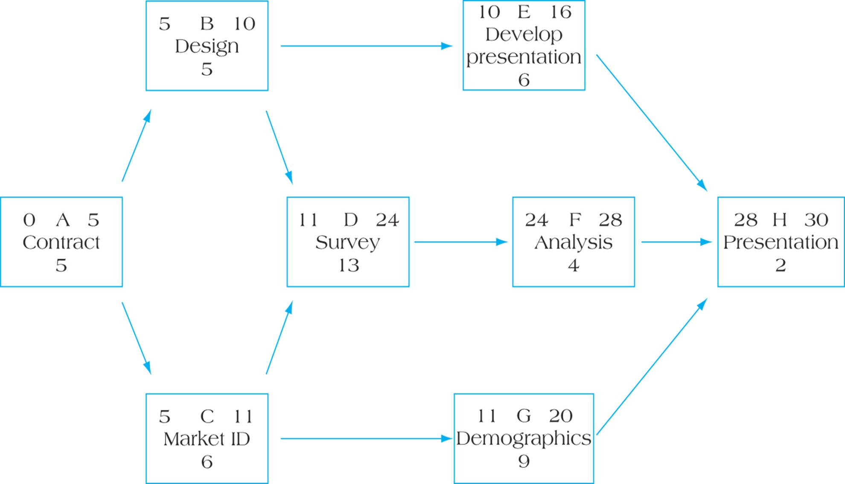
More of the Network
FIGURE 9.18 Activity Network with Forward Pass

Slide 12
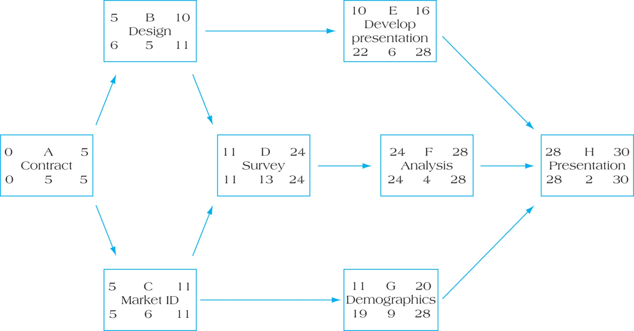
What would the Late Finish and Late Start be?
FIGURE 9.19 Activity Network with Backward Pass
Where is the critical path, we think of critical path as the longest?

Slide 13
Figure 9.19 Activity Network with Backward Pass
Where is the critical path, we think of critical path as the longest?
From our key for our node, fill in the “Activity Float” numbers

Slide 14
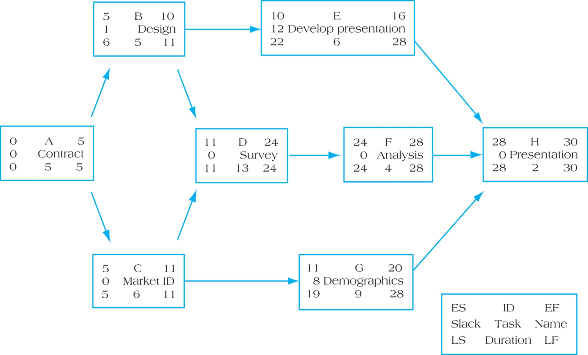
Figure 9.20 Project Network with Activity Slack and Critical Path
What does “Activity Float” or slack really mean?
*Float / Slack = LF-EF or LS-ES
* Critical Path is the network path(s) with no float/slack
Notes:
Float/slack, what does it mean? If we look at Activity G (Demographics), it has 8 days of slack. Activity G can be finished up to 8 days than the original Early Finish date (20 days), and it won’t delay the planned project completion of 30 days. Activity G might start 3 days late (e.g. on the 14th day) and take longer to complete than planned (e.g. 14 days instead of 9), and it will still be complete by the 28th, and won’t delay the overall project.

Slide 15
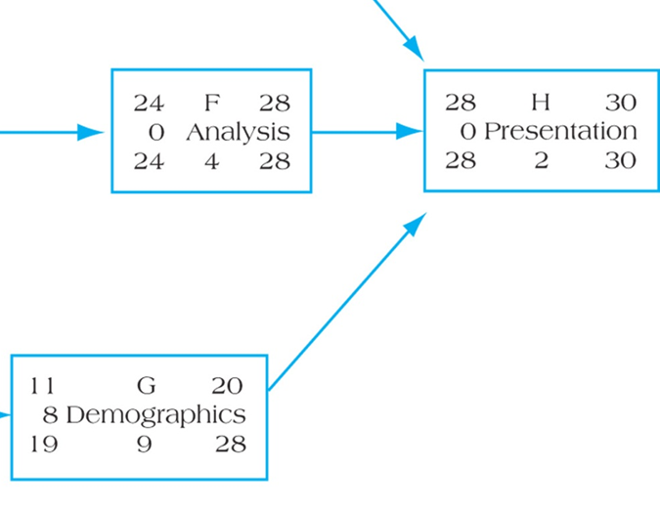
Critical Path
Our project critical path is A-C-D-F-H.
The critical path is the network path with no activity slack (float) associated with it, this makes it the longest path. Shorter paths would have some activities with positive slack (extra time).
Zero floats and positive slacks are common, but exceptions occur when a specific date or time constraint is used in the project, for example a LF (late finish) entered for the final task.
This results in a Negative Float.
A simple example, based on the forward pass the project should take 30 days. But if we wanted to see the impact of getting it done in 29 days (Task H’s LF = 29)?
What would be the LS for H, F and G?
Note in G we had a positive slack because LS 19 was larger than ES 11 (giving us a slack of +8), but with our LF change to H, What would be new slack for H?
Notes:
If LF for H is now 29, the LS would be 27. So the forward pass ES for H of 28 indicates that we should be able to start on the 28th day at the earliest. But we would have to start on the 27th which is earlier than our ES of 28. We don’t have extra time (slack), we don’t have enough time (negative slack), we have to start ahead of the durations on our network diagram. Our slack is -1.
For F the LF would change to 27, the LS to 23 (but our ES of F is 24). Same as above, we have negative slack of 1 day.
For G, our LF would be 27, our LS would 18. But unlike H and G above, we do have some slack, we can start as early as the 11th day but we have until the 18th day to start. 18-11 = +7, down from our original slack of +8.
Negative slack is a flag that we are going to have to change something in the plan such as shortening the duration of F or H by a day, in order to meet our new project duration of 29 days.
Technicality, when we say, for example, the ES for F on our original network diagram is 24, so we can start on the 24th day, we really mean we can start at the end of the 24th day (which is really the 25th day). The original network diagram was really scheduling F for 4 days, the 25th, 26th, 27th, and 28th.

Slide 16
What happens when we have two or more finals nodes? Project Twinning
Try drawing this network diagram
Do a forward pass and just start the backwards
Activity | Predecessor | Duration
A | None | 3
B | None | 2
C | A, B | 5
D | C | 3
E | D | 2
F | D | 3

Slide 17
At the final nodes the latest EF between the 2 activities becomes the LF for all final nodes, so we have slack in E.
1) So the LF in E is greater than the early finish
0 3
0 A
0 3 3
11 13 1 E
12 2 14
3 8
0 C
3 5 8
8 11
0 D
8 3 11
0 2
1 B
1 2 3
11 14
0 F
11 3 14
2) And if the 2 start activities have different durations, then one of them will have slack because the ES for both of them is 0. We would see this when we do our backwards pass and calculate our ES for B
Notes:
Another way of looking at the LF for E and F is as follows. E can finish in 13 days (the EF is 13), but because it’s waiting for F to finish (14 days), E can also finish as late as 14 days and not delay the project. So the LF for E becomes 14 also.

Slide 18
Duration Estimation, using Terms Traditionally applied in Cost Estimation
Duration Estimation (industry terms - symmetrical)
Ballpark, Rough Order of Magnitude (ROM), or SWAG ±30%
Comparative / Analogous ±15%
Feasibility ±10%
Definitive ±5%
PMBOK Guide using asymmetrical plus and minus numbers for estimates
PMBOK Rough Order of Magnitude (ROM)
Range from -25% to plus 75%
PMBOK definitive estimate
Range from -5% to plus 10%
Symmetrical?
These traditional cost terms are sometimes used in time estimates, particularly ROM

Slide 19
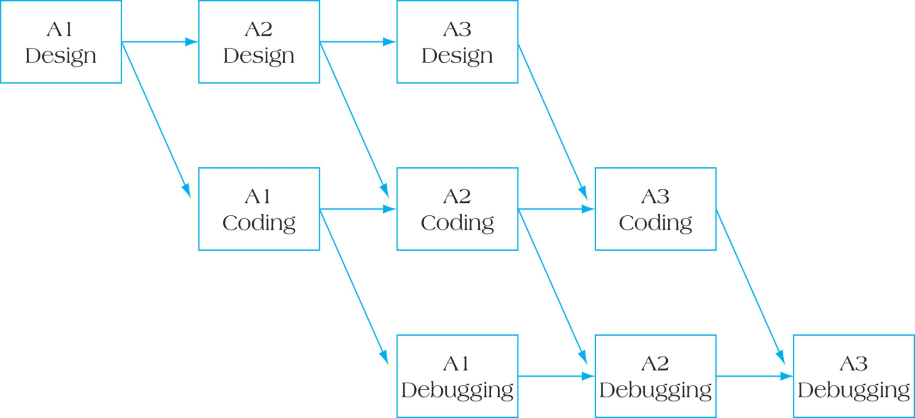
Laddering – Breaking Down Activities into Smaller Units
Figure 9.24
Why would we do this?
Notes:
We ladder to shorten the project duration.

Slide 20
Laddering Example
Project ABC can be completed in a shorter duration if the activities are broken down into smaller activities
A(3d)
B(9d)
C(6d)
ABC=18 days
A₁(1d)
A₂(1d)
A₃(1d)
Where is the critical path?
B₁(3d)
B₂(3d)
B₃(3d)
Laddered
ABC=12 days
C₁(2d)
C₂(2d)
C₃(2d)
A₁(1d)
B₁(3d)
C₁(2d)
Rearranged into 3 parallel projects
A₂(1d)
B₂(3d)
C₂(2d)
ABC=6 days
A₃(1d)
B₃(3d)
C₃(2d)
Notes:
In this example, we could have 3 activities we have to perform on each of storey of a 3-storey apartment building. In the first diagram, we perform A for all 3 of the storeys and then B for all 3 storeys, etc. In the 2nd diagram, A₁ means we are perform A on the first storey, then A₂ means we are performing on the second storey, etc.
The critical path for the red 2nd diagram is the longest path. By trial and error you can figure out the longest path would be A1, B1, B2, B3, C3 or 12 days. If you entered this project into MS Project it would automatically calculate the longest path.

Slide 21
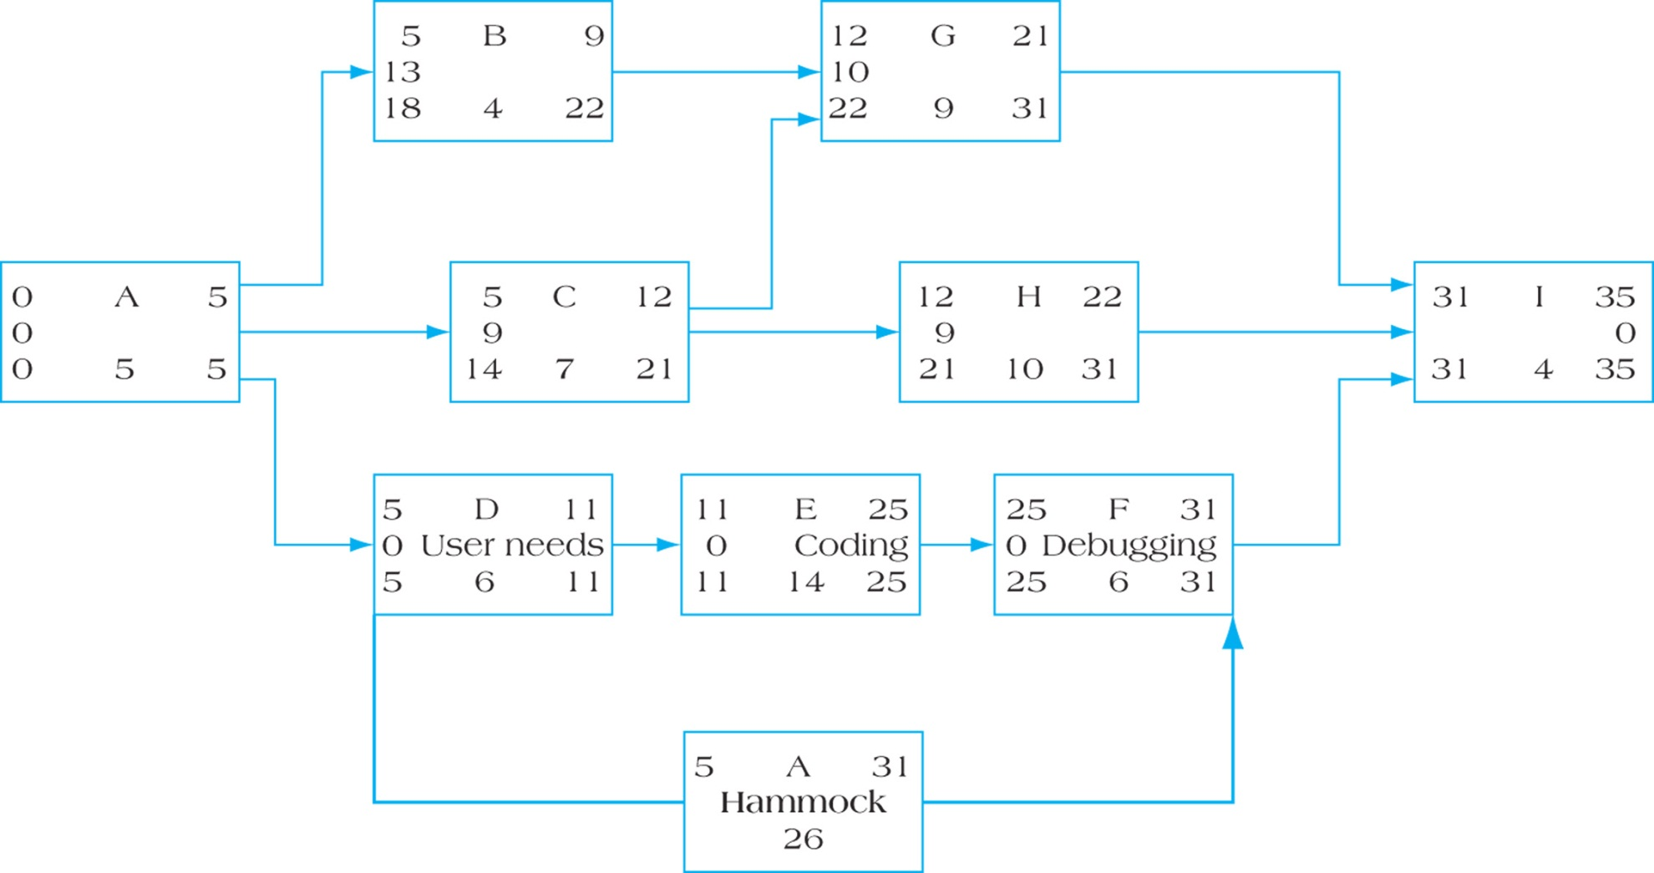
Hammock Activity on Critical Path
If you had a complex network diagram …
Figure 9.25
What is the duration for the Hammock & the ES, EF, LS, LF?
What if this is now a Hammock?

Slide 22
Example Hammock Activity on Critical Path
5
31
Hammock?
0
Figure 9.25
5
26
31
Note the Slack is zero and EF and LF are the same

Slide 23
Example Hammock Activity NOT on Critical Path
3
9
9
23
23
29
2
2
2
Hammock?
Figure 9.25
What if D-E-F were not on the critical path and had the information above, what would be duration, ES, EF, LS, LF and the slack for the Hammock?

Slide 24
Example Hammock Activity NOT on Critical Path
3
9
9
23
23
29
2
2
2
Hammock?
3
29
2
Figure 9.25
5
26
31
Note the Slack is NOT zero and EF and LF are different.
The slack is the same for activities D, E and F but they are NOT cumulative. D or E or F can be 2 days late, but not all of them.
If D is 1 day late than E or F (not both) could be another day late.

Slide 25
Reducing the Critical Path
Eliminate tasks on the Critical Path (CP)
Convert serial paths to parallel when possible
Overlap sequential tasks (e.g. laddering)
Shorten the duration on critical path Activities
Shorten
early tasks
longest tasks
easiest tasks
tasks that cost the least to speed up
How many different ways could we reduce a critical path?
Why is it so important to reduce the critical path?
Notes:
How many different ways could we reduce a critical path?
There are numerous ways to reduce the critical path depending on how critical it is to shorten the project duration. More human resources, more skilled resources, work overtime, work weekends, work 3 shifts a day or up to 21 shifts per week, pre-stage work via new activities, change the activities in a WP with new faster activities, duplicate activities in parallel, reduce scope, defer some scope to just after a deadline, renegotiate the deadline, if the deadline is Friday at 5PM would they accept the following Monday at 7AM, shift from making to buying, subcontract out, etc.
Why is it so important to reduce the critical path?
A project’s duration is dictated by the length of the critical path. Organizations generally invest in projects expecting a benefit, and they want payback on the funds invested in the project sooner rather then later. If a project was being performed for a customer there could be late penalties. If a project takes to long, it could be cancelled because the situation has changed and the project is no longer viable, and the investment is lost.

Slide 26
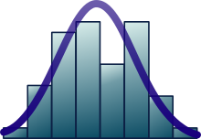
Duration or Cost, using Basic Statistics
Mean
Standard Deviation (Sigma σ)
Variance (the square
of standard deviation)
Project Variance (and Project Sigma)
Probability distribution and Z (number of standard deviations)
Retrieved from https://en.wikipedia.org/wiki/Normal_distribution

Slide 27
Variance & Standard Deviation
Variance and particularly Standard Deviation are a measure of the width of a normal distribution curve. Variance is the square of Standard Deviation.
Rough Order of Magnitude (ROM) estimates, which could be called Ballpark or SWAG estimates, would have a larger standard deviation than a more precise definitive estimate
Experiment with this online tool to “see” how a standard deviation is calculated from a range of numbers. For example 8 numbers for what you think a new cell phone cost would be if you were purchasing it -- or 8 numbers for the duration it might take to decide on a phone, source it, and buy it https://www.mathsisfun.com/data/standard-deviation-calculator.html At the bottom of the web page, you will see -1SD and +1SD, this means 68% of the estimates would fall between the two

Slide 28
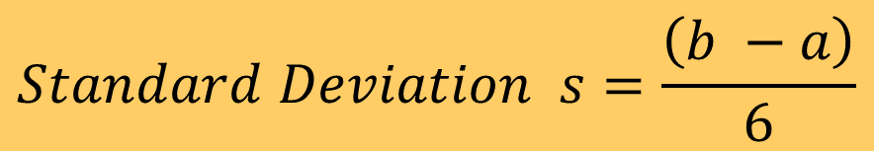
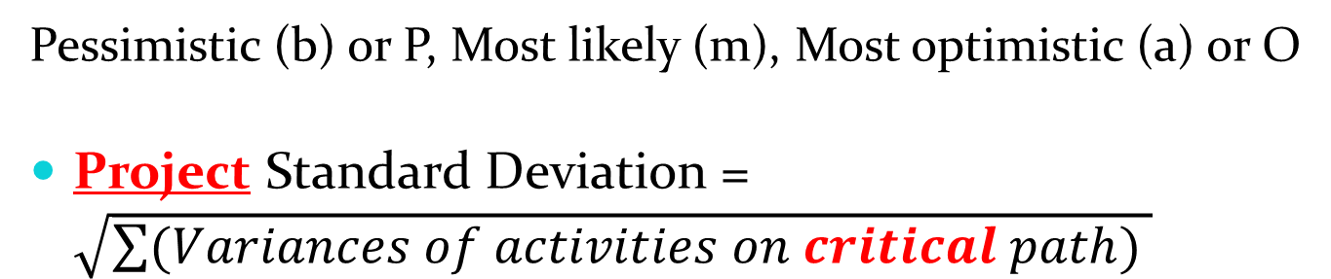
Project Standard Deviation Probability of Project Completion
PERT formula for calculating the duration from O, M, P
$$Standard Deviation s=\frac{\left(b −a\right)}{6}$$
Simple formula for a Standard Deviation using just pessimistic & optimistic estimates
Standard Deviation (s), squared, is the Variance
Pessimistic (b) or P, Most likely (m), Most optimistic (a) or O
Project Standard Deviation = $\sqrt{\sum{(Variances of activities on critical path) }}$

Slide 29
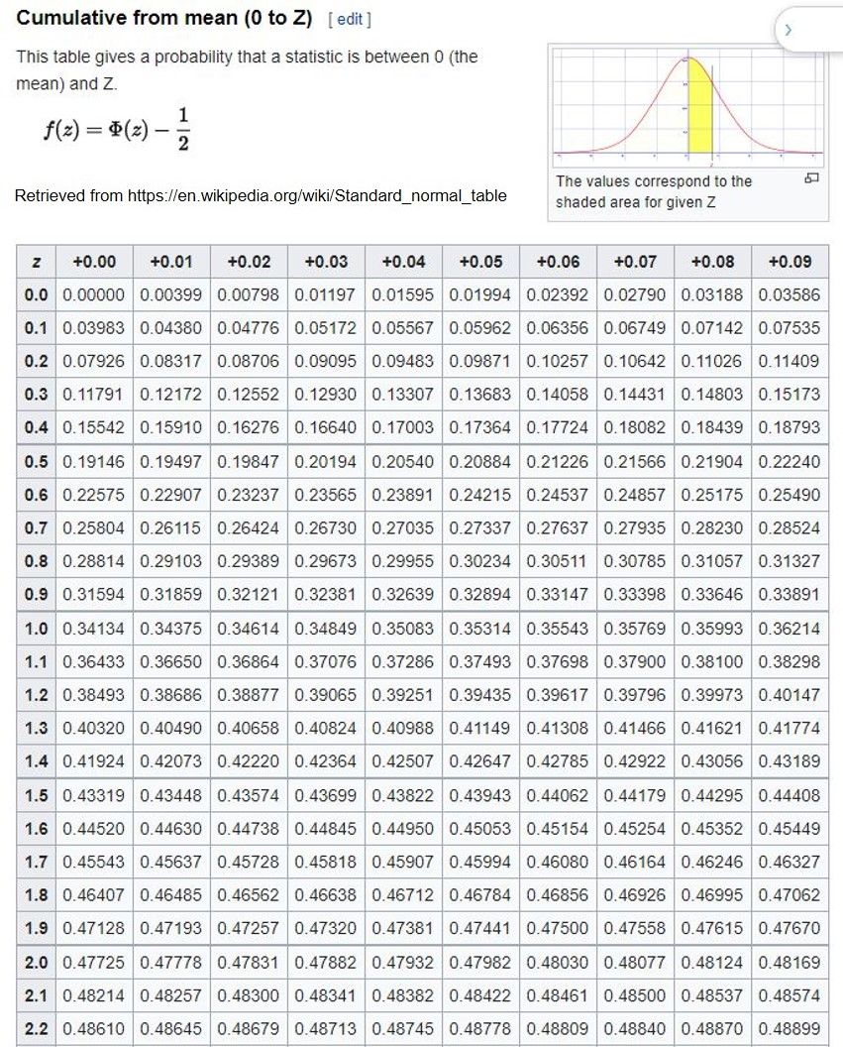
Probability Distribution
We can use this Z table to determine the probability of a scenario duration for a project, but we need to know:
Estimated project duration
Project standard deviation from the project variance
What is the duration mentioned in the scenario
Z, via a calculation
And then we can use the Z table to determine the probability
Note the key above, for the Z Table

Slide 30
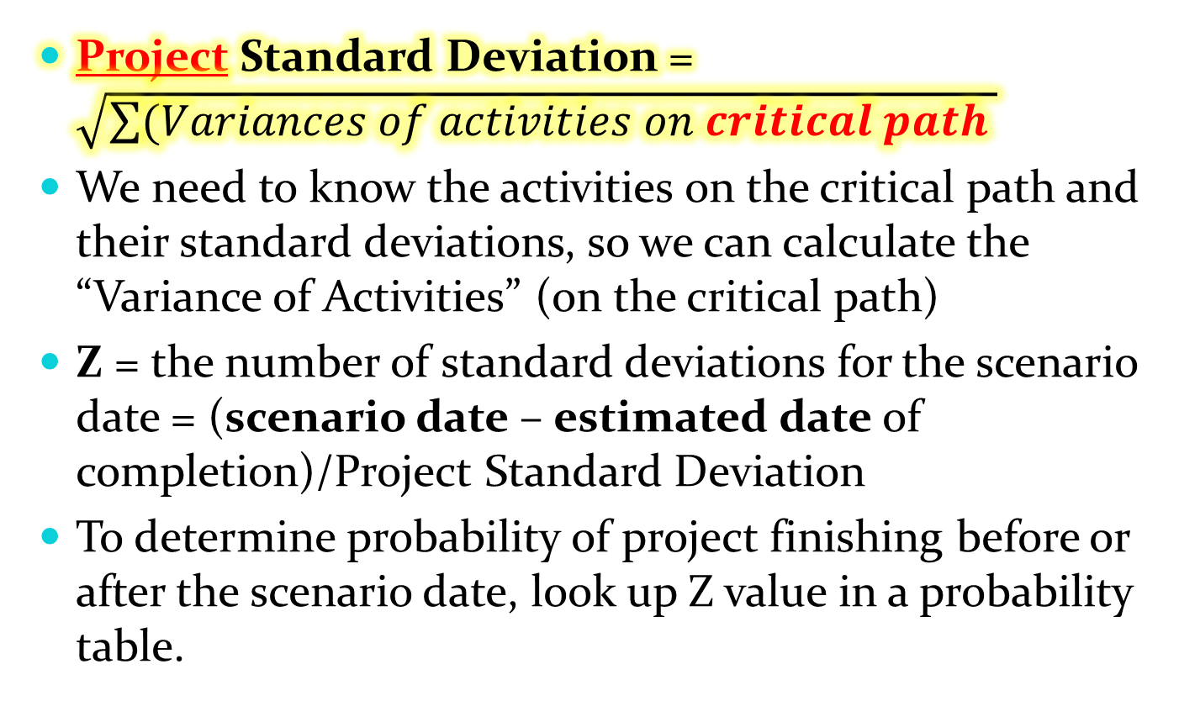
Probability of Project Completion (cont’d)
We are focusing on the variability of the project duration, but using individual activity durations to do so
Project Standard Deviation = $\sqrt{\sum{(Variances of activities on critical path }}$
We need to know the activities on the critical path and their standard deviations, so we can calculate the “Variance of Activities” (on the critical path)
Z = the number of standard deviations for the scenario date = (scenario date – estimated date of completion)/Project Standard Deviation
To determine probability of project finishing before or after the scenario date, look up Z value in a probability table.

Slide 31
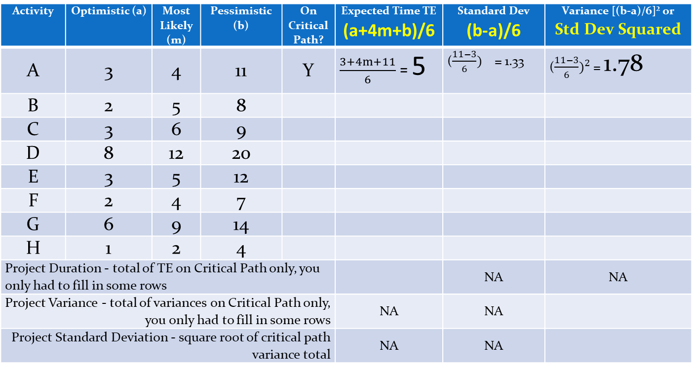
What is the Probability of Project Delta Probability less than 32 weeks?
Activity | Optimistic (a) | Most Likely (m) | Pessimistic (b) | On Critical Path? | Expected Time TE (a+4m+b)/6 | Standard Dev (b-a)/6 | Variance [(b-a)/6]² or Std Dev Squared
A | 3 | 4 | 11 | Y | $\frac{3+4m+11}{6}$ = 5 | (${\frac{11−3}{6})}^{}$ = 1.33 | (${\frac{11−3}{6})}^{2}$ = 1.78
B | 2 | 5 | 8
C | 3 | 6 | 9
D | 8 | 12 | 20
E | 3 | 5 | 12
F | 2 | 4 | 7
G | 6 | 9 | 14
H | 1 | 2 | 4
Project Duration - total of TE on Critical Path only, you only had to fill in some rows |  |  |  |  |  | NA | NA
Project Variance - total of variances on Critical Path only, you only had to fill in some rows |  |  |  |  | NA | NA
Project Standard Deviation - square root of critical path variance total |  |  |  |  | NA | NA
Back to our Delta practice exercise but we now have new duration estimates in PERT format, but not TE nor variances yet, note critical path is A-C-D-F-H
Key message here is we can not add up standard deviations of activities to get the standard deviation for a project, we have to use the Project Duration Formula

Slide 32
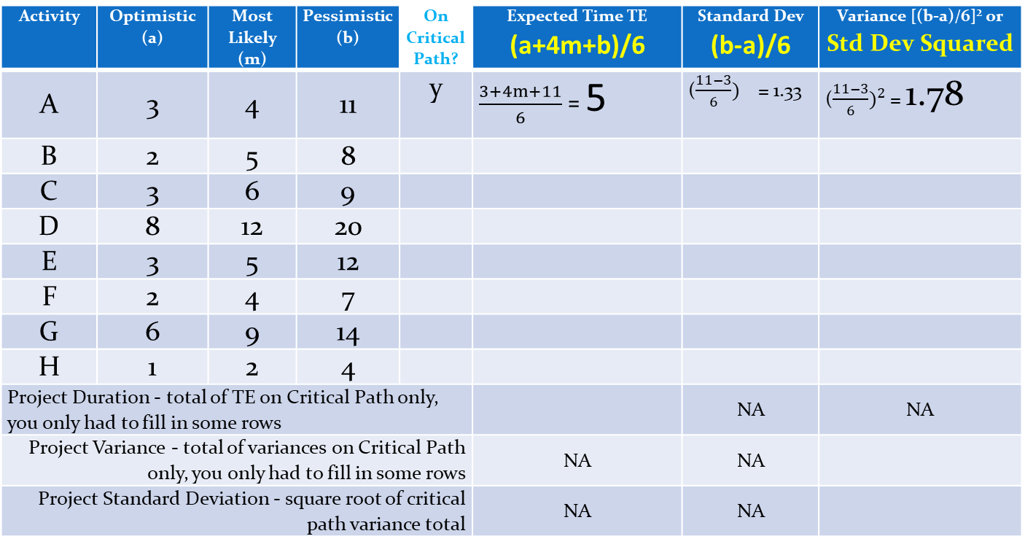
What is the Probability of Project Probability less than 32 weeks? What are the critical path Activity Variances & critical path Variance?
Activity | Optimistic (a) | Most Likely (m) | Pessimistic (b) | On Critical Path? | Expected Time TE (a+4m+b)/6 | Standard Dev (b-a)/6 | Variance [(b-a)/6]² or Std Dev Squared
A | 3 | 4 | 11 | y | $\frac{3+4m+11}{6}$ = 5 | (${\frac{11−3}{6})}^{}$ = 1.33 | (${\frac{11−3}{6})}^{2}$ = 1.78
B | 2 | 5 | 8
C | 3 | 6 | 9
D | 8 | 12 | 20
E | 3 | 5 | 12
F | 2 | 4 | 7
G | 6 | 9 | 14
H | 1 | 2 | 4
Project Duration - total of TE on Critical Path only, you only had to fill in some rows |  |  |  |  |  | NA | NA
Project Variance - total of variances on Critical Path only, you only had to fill in some rows |  |  |  |  | NA | NA
Project Standard Deviation - square root of critical path variance total |  |  |  |  | NA | NA
M4 PRINTOUT or DIGITAL Std Dev on critical path Delta proj.docx
Printout
or
Use this Slide
Note critical path is A-C-D-F-H
Fill out the rest of the table - only do the critical path

Slide 33
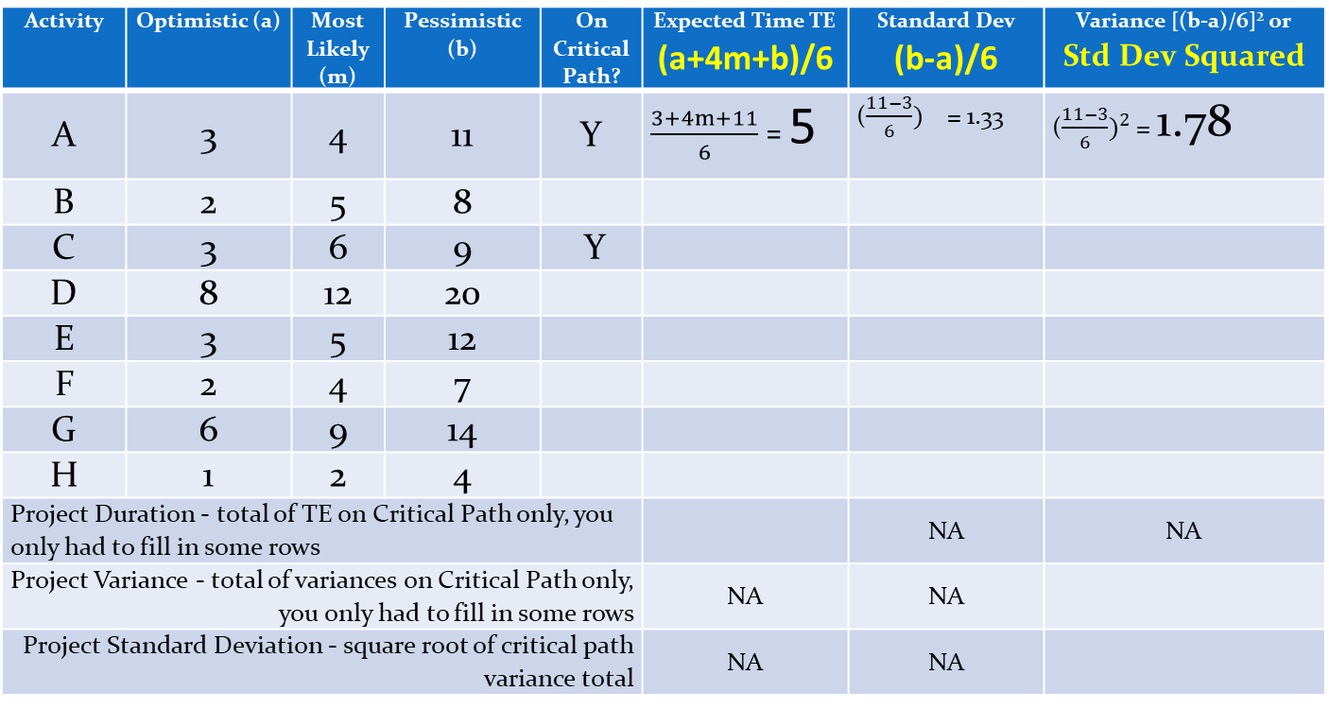
Probability of Project Completion Probability less than 32 weeks?
Activity | Optimistic (a) | Most Likely (m) | Pessimistic (b) | On Critical Path? | Expected Time TE (a+4m+b)/6 | Standard Dev (b-a)/6 | Variance [(b-a)/6]² or Std Dev Squared
A | 3 | 4 | 11 | Y | $\frac{3+4m+11}{6}$ = 5 | (${\frac{11−3}{6})}^{}$ = 1.33 | (${\frac{11−3}{6})}^{2}$ = 1.78
B | 2 | 5 | 8
C | 3 | 6 | 9 | Y
D | 8 | 12 | 20
E | 3 | 5 | 12
F | 2 | 4 | 7
G | 6 | 9 | 14
H | 1 | 2 | 4
Project Duration - total of TE on Critical Path only, you only had to fill in some rows |  |  |  |  |  | NA | NA
Project Variance - total of variances on Critical Path only, you only had to fill in some rows |  |  |  |  | NA | NA
Project Standard Deviation - square root of critical path variance total |  |  |  |  | NA | NA
Start by filling out the 4 columns for Activity C (we skip B as it is NOT on the critical path)
Use this Slide
Note critical path is A-C-D-F-H

Slide 34
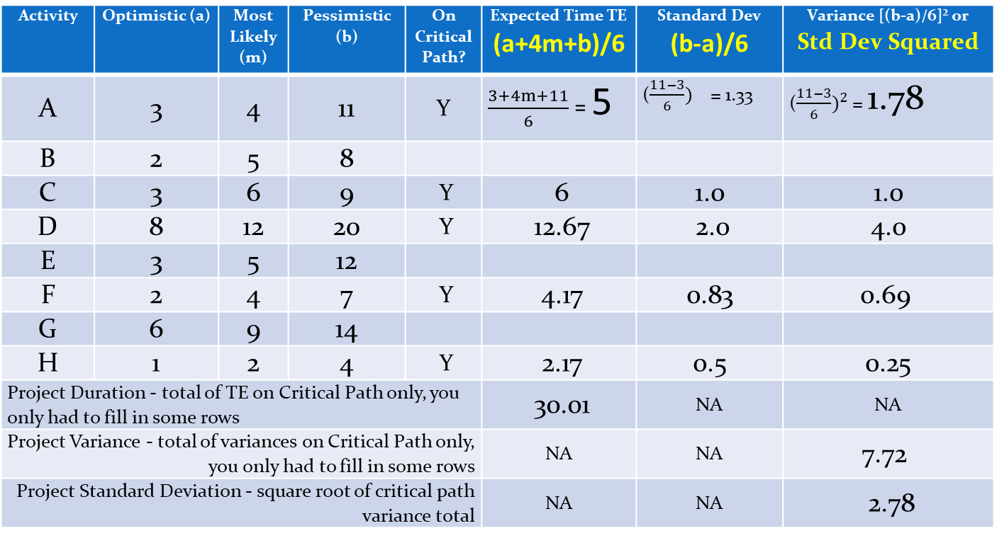
Probability of Project Probability less than 32 weeks? What is Project Std Deviation and Z?
Activity | Optimistic (a) | Most Likely (m) | Pessimistic (b) | On Critical Path? | Expected Time TE (a+4m+b)/6 | Standard Dev (b-a)/6 | Variance [(b-a)/6]² or Std Dev Squared
A | 3 | 4 | 11 | Y | $\frac{3+4m+11}{6}$ = 5 | (${\frac{11−3}{6})}^{}$ = 1.33 | (${\frac{11−3}{6})}^{2}$ = 1.78
B | 2 | 5 | 8
C | 3 | 6 | 9 | Y | 6 | 1.0 | 1.0
D | 8 | 12 | 20 | Y | 12.67 | 2.0 | 4.0
E | 3 | 5 | 12
F | 2 | 4 | 7 | Y | 4.17 | 0.83 | 0.69
G | 6 | 9 | 14
H | 1 | 2 | 4 | Y | 2.17 | 0.5 | 0.25
Project Duration - total of TE on Critical Path only, you only had to fill in some rows |  |  |  |  | 30.01 | NA | NA
Project Variance - total of variances on Critical Path only, you only had to fill in some rows |  |  |  |  | NA | NA | 7.72
Project Standard Deviation - square root of critical path variance total |  |  |  |  | NA | NA | 2.78
Note critical path is A-C-D-F-H

Slide 35
Duration Contingency Reserves
In MGMT-6056 Cost Management we will be covering Contingency Reserves costs, extra funds for things we know potentially could go wrong. But in MGMT-6058 we note that it’s also possible to create a Duration Contingency Reserve, extra time (duration) for our project for things we know potentially could go wrong.
An example, we estimate our TE PERT for our project to be 40 days. There will be a large penalty for being late, so we add a 5 day Duration Contingency Reserve.
Our duration budget for the project with a reserve is now 45 days.
We would start our project at least 45 days before a penalty deadline.

Slide 36
Probability Distribution Probability less than 32 weeks?
We can use this Z table to determine the probability of a scenario date for a project, but we need to know:
Estimated project duration
Project standard deviation from the project variance
What is the scenario date
Z, via a calculation
And then we can use the Z table to determine the probability
Note the key for the Z Table

Slide 37
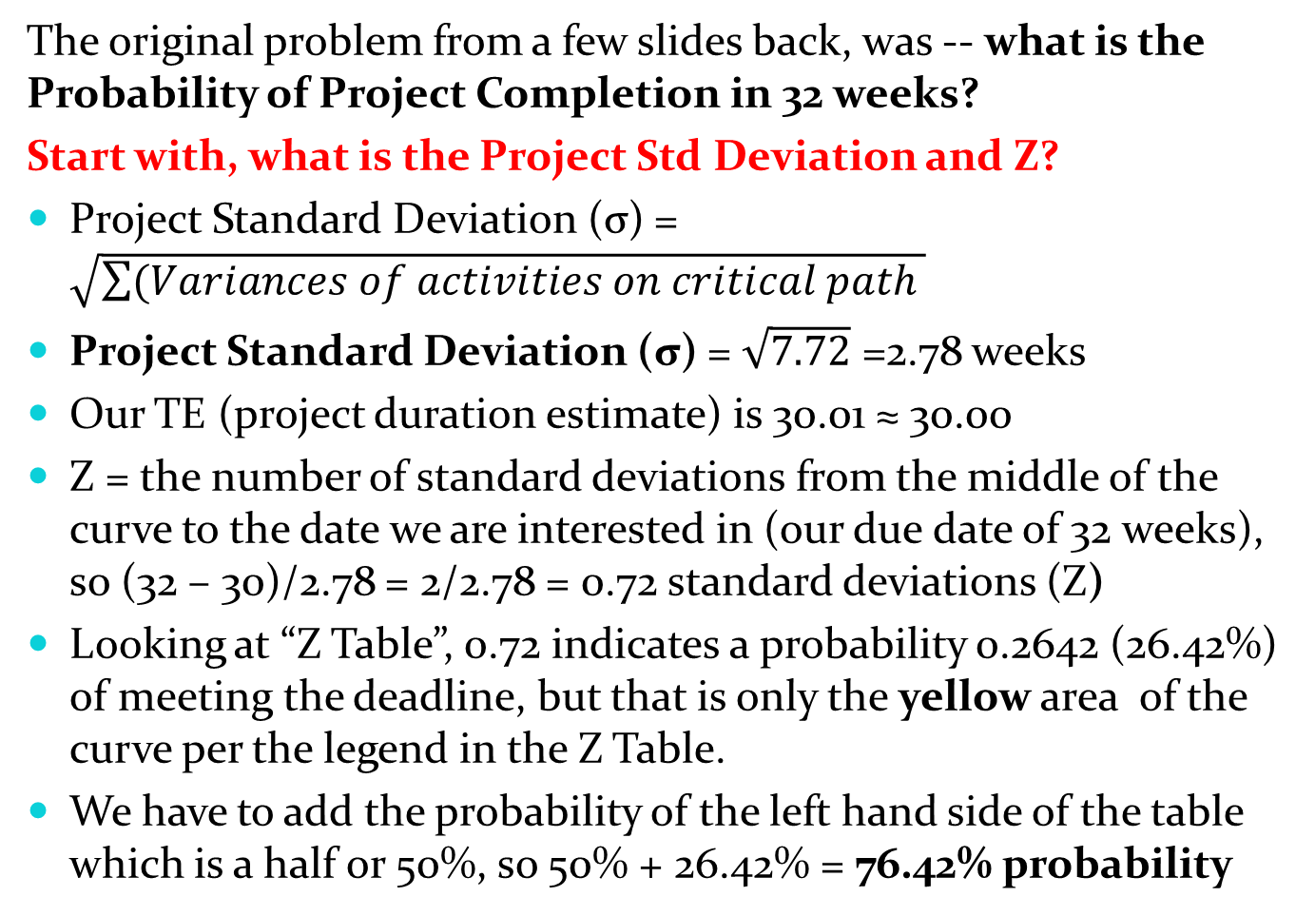
Probability of Project Completion (cont’d)
The original problem from a few slides back, was -- what is the Probability of Project Completion in 32 weeks?
Start with, what is the Project Std Deviation and Z?
Project Standard Deviation (σ) = $\sqrt{\sum{(Variances of activities on critical path }}$
Project Standard Deviation (σ) = $\sqrt{7.72}$ =2.78 weeks
Our TE (project duration estimate) is 30.01 ≈ 30.00
Z = the number of standard deviations from the middle of the curve to the date we are interested in (our due date of 32 weeks), so (32 – 30)/2.78 = 2/2.78 = 0.72 standard deviations (Z)
Looking at “Z Table”, 0.72 indicates a probability 0.2642 (26.42%) of meeting the deadline, but that is only the yellow area of the curve per the legend in the Z Table.
We have to add the probability of the left hand side of the table which is a half or 50%, so 50% + 26.42% = 76.42% probability

Slide 38
But what if we had a Negative Z?
In the last problem, if we had a different due date (scenario date) of 28 weeks, our Z would be negative (to the left of our estimate date of 30 on a distribution curve)
What is our probability of completion less than 28 days, is less than 30, so we will have a negative Z
Z = the number of standard deviations on the due date = (28 – 30)/2.78 = -0.72 (note the minus sign)
We would have to use a Negative Z with the table we have which is a challenge so we are first going to use an online tool (below), and then the Z table
M4 Math is Fun, Standard Normal Distribution Table
https://www.mathsisfun.com/data/standard-normal-distribution-table.html
With the online tool above, use the radio button setting “Up to Z” and when you slide Z to be -0.72, the probability for the left hand tail of the curve is 23.58%

Slide 39
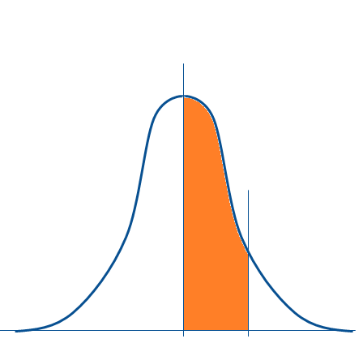
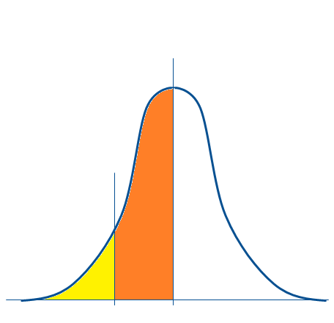
But could we look up the answer for Z, using our Probability Distribution Z Table?
1) We can’t look up a negative Z with our table, but we can look up a positive Z of 0.72. The area would be 26.42%
2) If we flip the area from the right side to the left, we are on the negative Z side. This area would still be 26.42%
3) This line represents the duration we’re interested in, 28 weeks
Follow steps 1 through 4
4) But what we’re interested in, is the probability less than 28 weeks, we know the yellow and orange areas = ½ of the curve, so 50% - 26.42% = 23.58% probability

Slide 40
Reverse Approach When Probability of Completion is Given We are given a 95% probability, what is the scenario date?
To determine the due date to achieve a certain probability of a project finishing by a certain date, we use the same formula but in a different order. We are going to use an online tool to help us translate the probability into a Z, and the use the Z table to find the due date. Due Date = Expected date of completion + (Z x σ)
To ensure a 95% likelihood of completing on time, the Due Date would have to be ________ weeks.
Use the link with the interactive chart, and then try using the Z table in this PPT to calculate the Due Date 2 different ways
M4 Math is Fun, Standard Normal Distribution Table
https://www.mathsisfun.com/data/standard-normal-distribution-table.html

Slide 41
Probability Distribution Calculations – 2 Ways
1) Using the radio button “up to Z” setting on the interactive chart link below, find the Z for 95% probability
Note the key for the Z Table
M4 Math is Fun, Standard Normal Distribution Table
https://www.mathsisfun.com/data/standard-normal-distribution-table.html
2) Using the Z Table on this slide, find the Z for 95% probability, note the legend in the top right of the table. You can’t look up 95% directly, the legend indicates the yellow area only covers up to ½ of the area under the curve, you’d have to look up 45% or 0.45

Slide 42
Probability of Project Completion (cont’d) What would be the scenario date?
To determine the due date to achieve a certain probability of a project finishing by a certain date
Due Date = Expected date of completion + (Z x σ)
To ensure a 95% likelihood of completing on time Z = 1.64 (or 1.65 see below). Due Date would have to be:
30 + 1.64 x σ (standard deviation) = 30 + 1.64 x 2.78 = 34.559 weeks ≈ 34.6 weeks
But using the interactive chart link, you might have picked 1.65 for Z as you can’t select exactly 95% 30 + 1.65 x 2.78 = 34.587 weeks ≈ 34.6 weeks

Slide 43
Summary
Constructing the critical path for a project schedule network via forward and backward passes.
Identifying how to determine activity float/slack.
For duration estimates, apply common forms of estimation for project work, including ROM, ballpark estimates and definitive estimates – with PMBOK estimates as well.
Laddering and Hammocks
Understand the steps that can be employed to reduce the critical path.
Duration Contingency Reserves
Calculate the probability of a project finishing on time using Statistical PERT estimates.

Slide 44
Homework
Refer to the Start Here section of this module
Read for the next module
Kerzner 12th Ed p 432-442, 11th p. 620-633
PMBOK 6th Ed 6.2-6.6, 5th 6.2-6.7
Review PPT files with solutions
Assignments, practice quizzes and graded quizzes, check the Course at a Glance and FOL/Content/Course Assignments & FOL/Evaluations/Quizzes

Slide 45

Copyright © 2013 Pearson Education, Inc. Publishing as Prentice Hall

